Slide 1
Employee Attrition Analysis
By Akash Redkar

Slide 2
INTRODUCTION
Welcome aboard our journey into the Employee Attrition Analysis project for XYZ Company. Here, we dive deep into understanding the reasons behind our employees' departure, all in an effort to empower our organization with insights for smarter decision-making.

Slide 3
Objectives
Identify Patterns: Dive into employee data to unveil underlying trends and patterns associated with attrition.
Understanding Drivers: Pinpoint the pivotal factors fueling employee turnover within the organization.
Visualize Insights: Craft engaging visual representations to illustrate and simplify complex findings.
Enable Decision-Making: Equip XYZ Company's leadership with actionable insights to inform strategic workforce management decisions effectively.

Slide 4

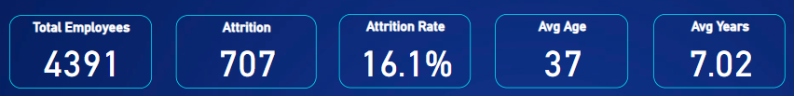
Main KPI’s
Total Employees - Represents the total number of employees in the organization.
Attrition Rate - Indicates the percentage of employees who have left the company within a specific time period.
Average Age - Denotes the average age of employees in the organization.
Average Years of Service - Reflects the average duration of employment among the workforce.
Represents the total number of employees who have left the company within a specific time period.

Slide 5
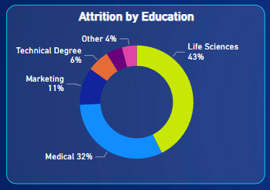
Educational Background and Employee Attrition
This pie chart illustrates attrition rates by education background, emphasizing the high attrition rate in Life Sciences (43%) and Medical (32%), followed by Marketing (11%), Technical Degree (6%), and Other (4%)

Slide 6
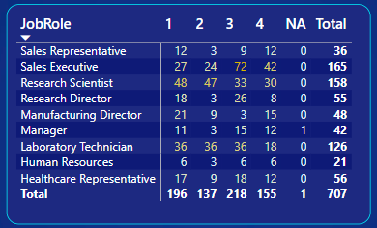
Attrition Analysis by Job Role and Job Satisfaction
This table shows the distribution of job satisfaction ratings for different job roles. The columns represent job satisfaction ratings, from 1 (Very Dissatisfied) to 4 (Satisfied) and NA (Not Applicable) The rows represent job roles and the total is count of attrition.

Slide 7
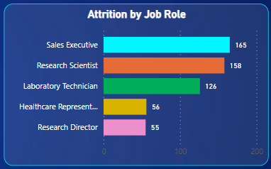
Employee Attrition Across Job Roles
This Bar Graph Visualizes the attrition rates for various job roles: Sales Executive, Research Scientist, Laboratory Technician, Healthcare Representative, and Research Director. The highest attrition rate is seen in Sales Executive (165) as seen in the graph.

Slide 8
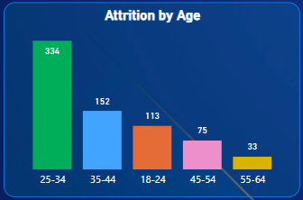
Age Distribution and Employee Turnover
This bar graph highlights attrition rates across age groups: 18-24 (334), 35-44 (152), 18-24 (113), 45-54 (75), and 55-64 (33). The highest attrition rate is found in the 25-34 age group.

Slide 9
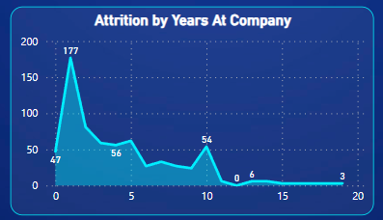
Employee Tenure and Attrition Analysis
This area chart displays attrition rates based on years at the company. The highest attrition rate is found in the 1 year mark, with a value of 177.

Slide 10
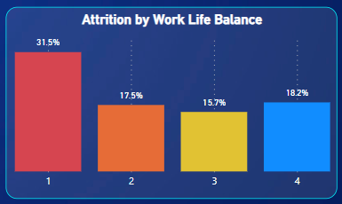
Attrition Analysis by Work-Life Balance
The Graph Shows attrition rates based on work-life balance ratings, from 1 (Struggling) to 4 (Highly Balanced). The Graph also highlights the percentage of employees who left the company (Attrition) in each work-life balance category.

Slide 11
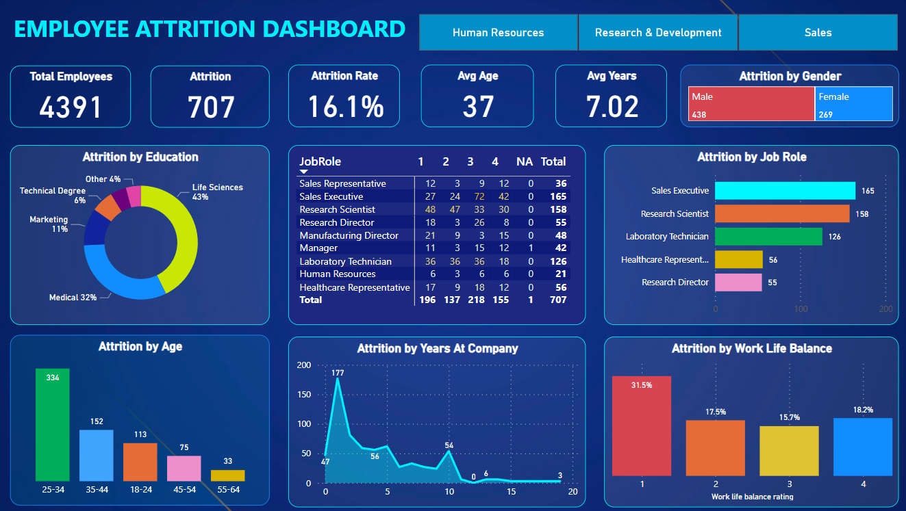
Final Dashboard Overview

Slide 12






thanks!
Template Credit :

